Slide 1
Structure From Motion

Slide 2
Can we estimate distance from one image?

Slide 3
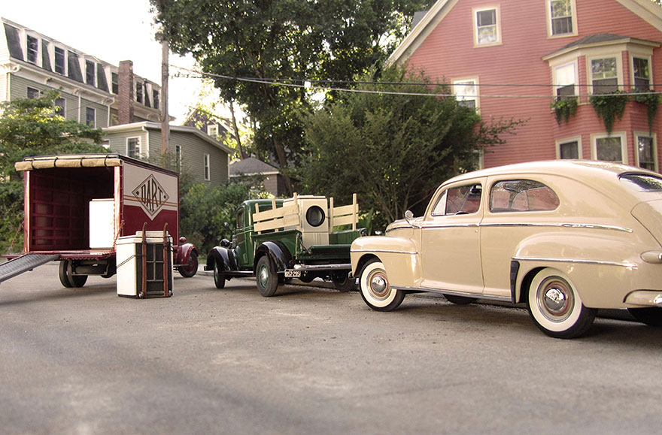
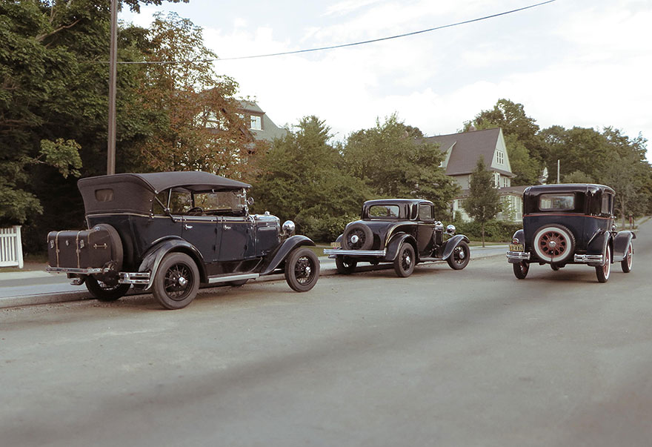
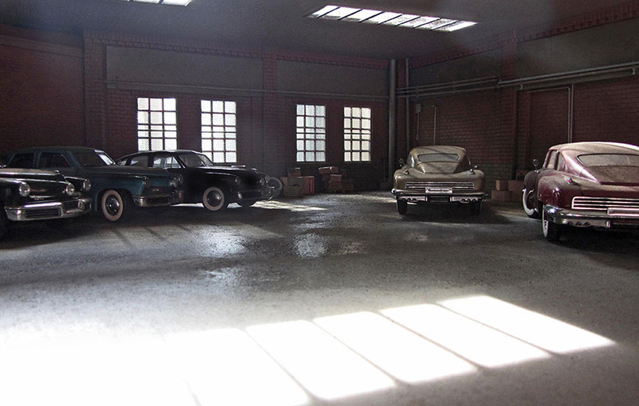
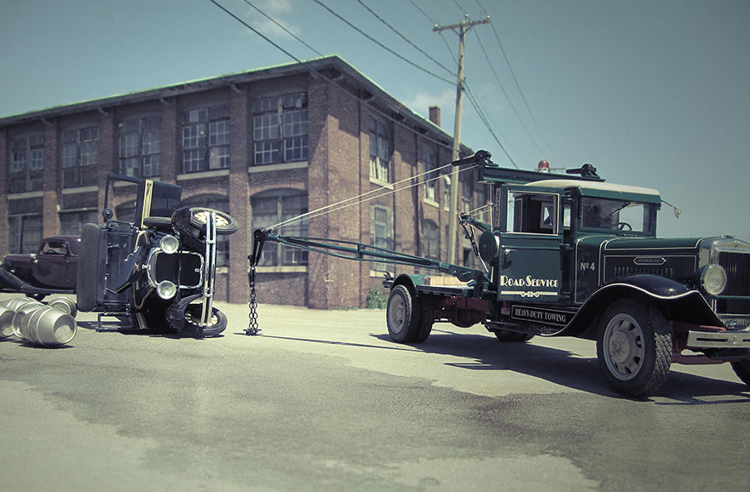

Slide 4
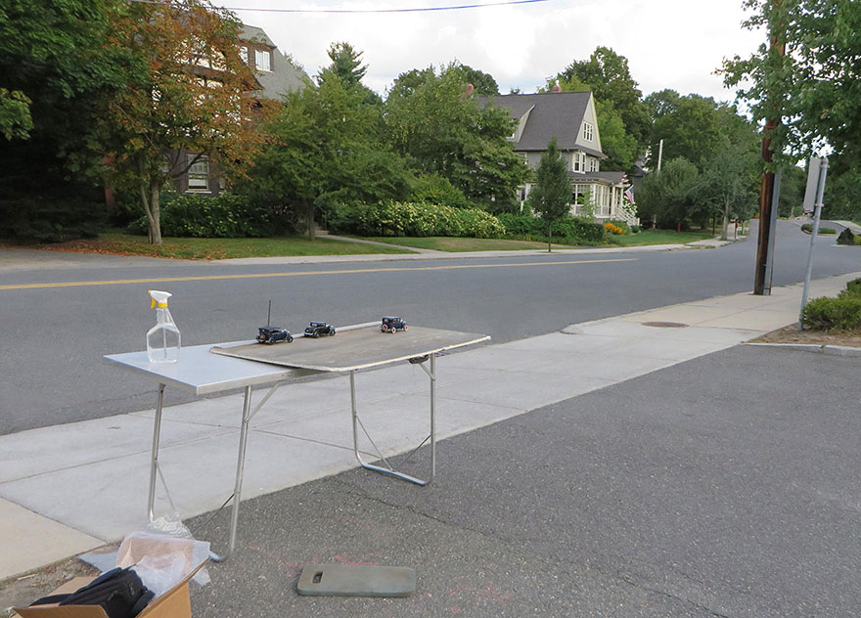

Slide 5
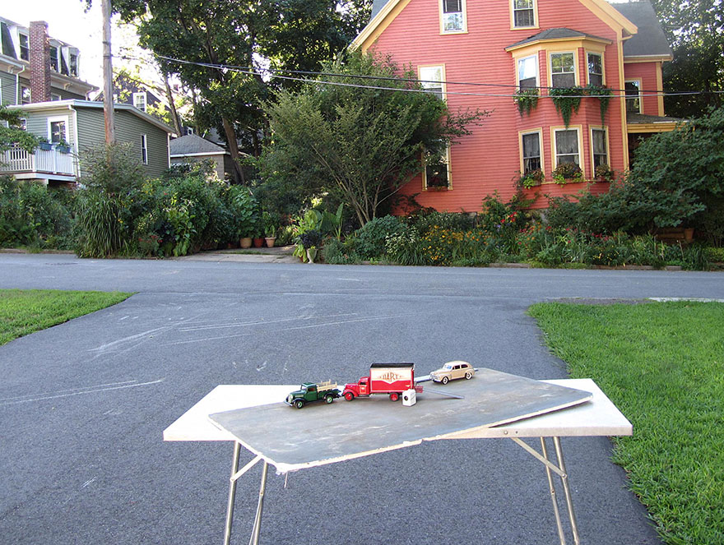

Slide 6
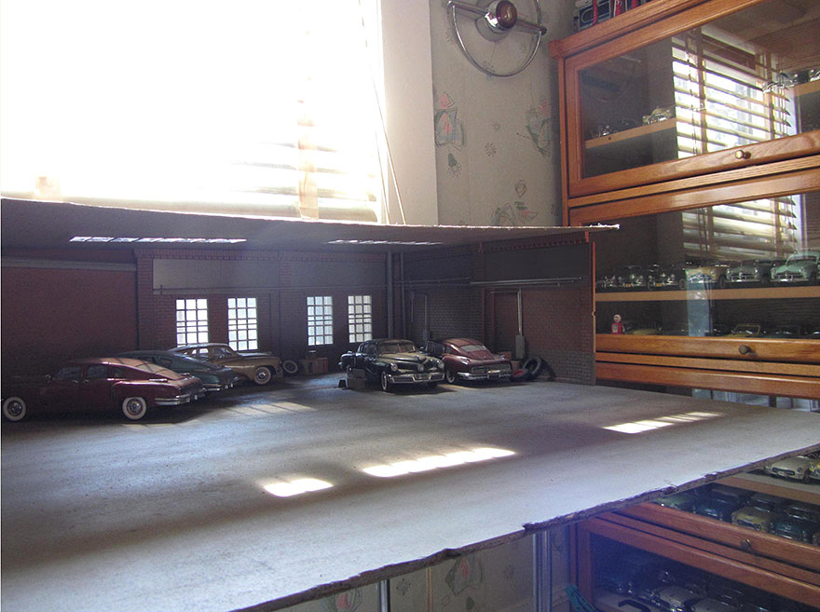

Slide 7
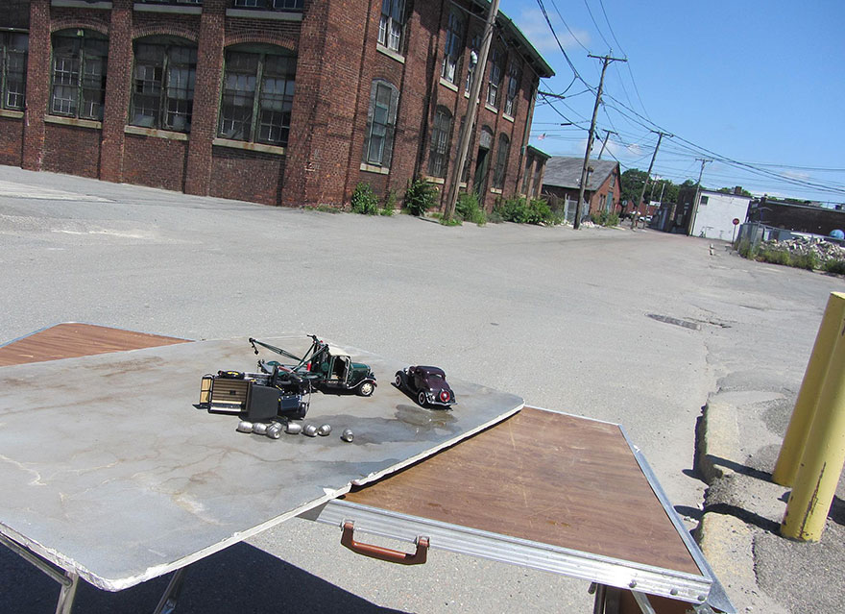

Slide 8
What does a camera measure?

Slide 9
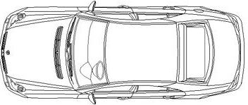
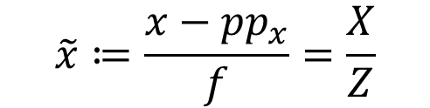
What does a camera measure?
Focal length
pinhole
rays
Principle Point
Sensor
X
Light intensity
X
Z
Z
$$\tilde{x}≔\frac{x−{pp}_{x}}{f}=\frac{X}{Z}$$

Slide 10
What does a camera measure?
Focal length
Principle Point
$$\tilde{x}≔\frac{x−{pp}_{x}}{f}=\frac{X}{Z}$$

Slide 11


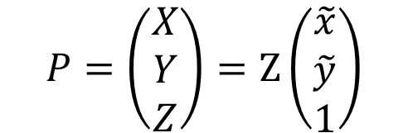
From pixels to rays
$$\tilde{x}=\frac{X}{Z}$$
X
$$\tilde{y}=\frac{Y}{Z}$$
Z
$$P=\left(\begin{matrix}X \\ Y \\ Z\end{matrix}\right)=Z\left(\begin{matrix}\tilde{x} \\ \tilde{y} \\ 1\end{matrix}\right)$$
x
f
f
x

Slide 12
So how can we estimate distance?

Slide 13
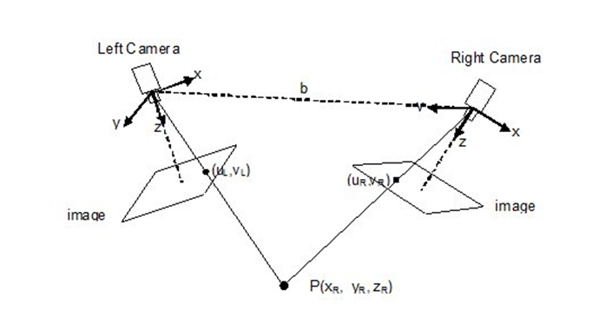
Stereo Vision

Slide 14
Structure From Motion (SFM)

Slide 15
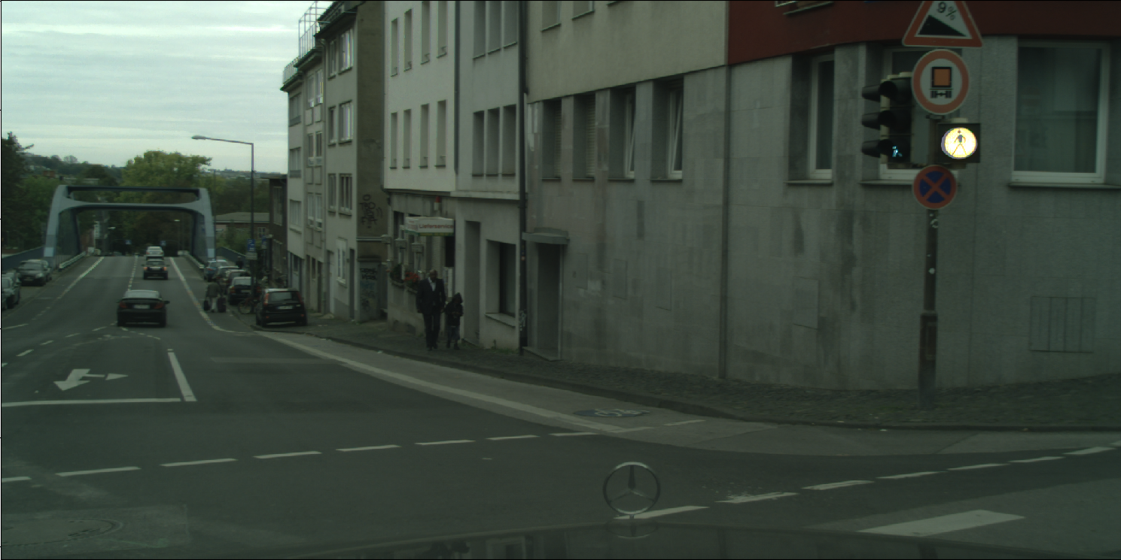
Previous

Slide 16
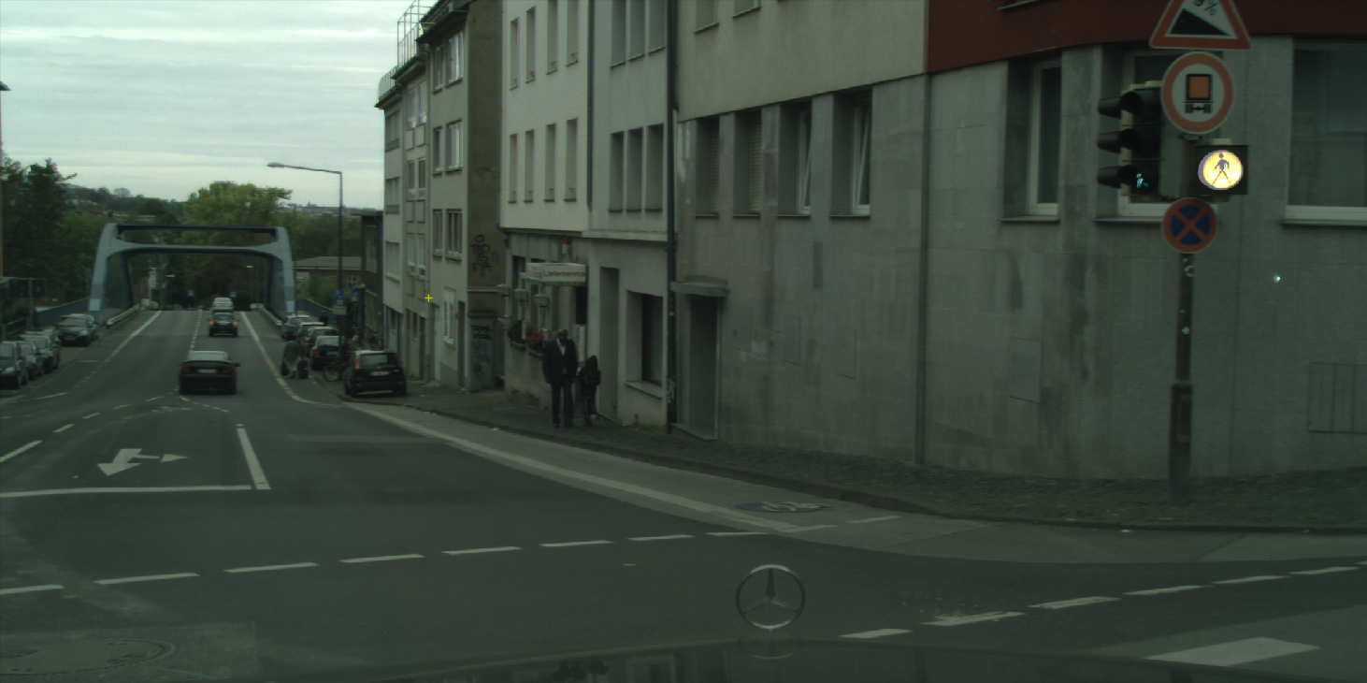
Current

Slide 17
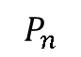
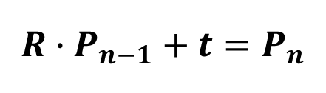
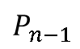
Ego Motion
Camera n, Z
$$P_{n}$$
Camera n, X
$$P_{n−1}$$
Translation
3 degrees of freedom
Camera n-1, Z
Rotation
3 degrees of freedom
$$R∙P_{n−1}+t=P_{n}$$
Camera n-1, X

Slide 18
Geometry of depth estimation

Slide 19
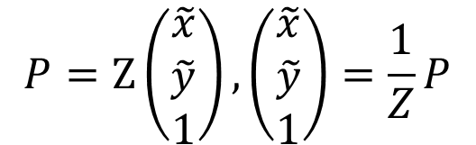
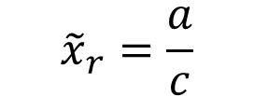
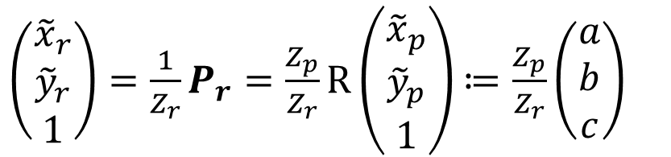
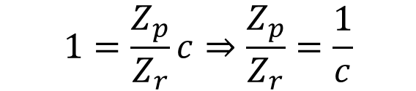
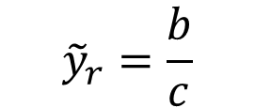
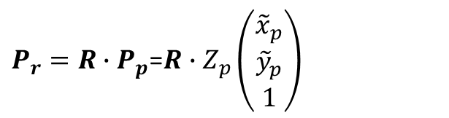
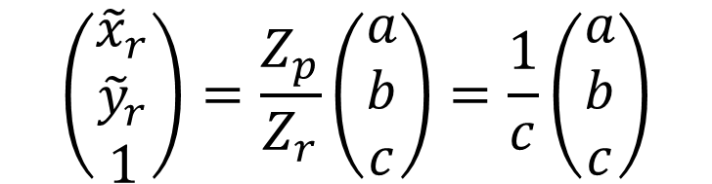
Handling the rotation
$$1=\frac{Z_{p}}{Z_{r}}c⇒\frac{Z_{p}}{Z_{r}}=\frac{1}{c}$$
$$P=Z\left(\begin{matrix}\tilde{x} \\ \tilde{y} \\ 1\end{matrix}\right),\left(\begin{matrix}\tilde{x} \\ \tilde{y} \\ 1\end{matrix}\right)=\frac{1}{Z}P$$
$$\left(\begin{matrix}{\tilde{x}}_{r} \\ {\tilde{y}}_{r} \\ 1\end{matrix}\right)=\frac{Z_{p}}{Z_{r}}\left(\begin{matrix}a \\ b \\ c\end{matrix}\right)=\frac{1}{c}\left(\begin{matrix}a \\ b \\ c\end{matrix}\right)$$
$P_{r}=R∙P_{p}$=$R∙Z_{p}\left(\begin{matrix}{\tilde{x}}_{p} \\ {\tilde{y}}_{p} \\ 1\end{matrix}\right)$
$\left(\begin{matrix}{\tilde{x}}_{r} \\ {\tilde{y}}_{r} \\ 1\end{matrix}\right)=\frac{1}{Z_{r}}P_{r}=\frac{Z_{p}}{Z_{r}}R\left(\begin{matrix}{\tilde{x}}_{p} \\ {\tilde{y}}_{p} \\ 1\end{matrix}\right)$ $≔\frac{Z_{p}}{Z_{r}}\left(\begin{matrix}a \\ b \\ c\end{matrix}\right)$
$${\tilde{x}}_{r}=\frac{a}{c}$$
$${\tilde{y}}_{r}=\frac{b}{c}$$

Slide 20
Previous

Slide 21
Current

Slide 22
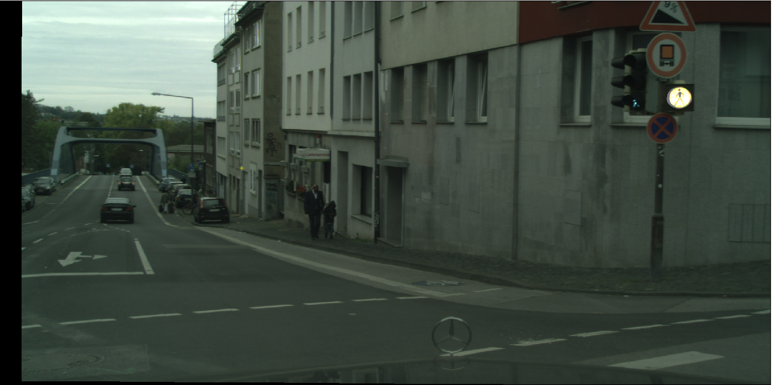
Previous - rotated

Slide 23
How do we match points?

Slide 24
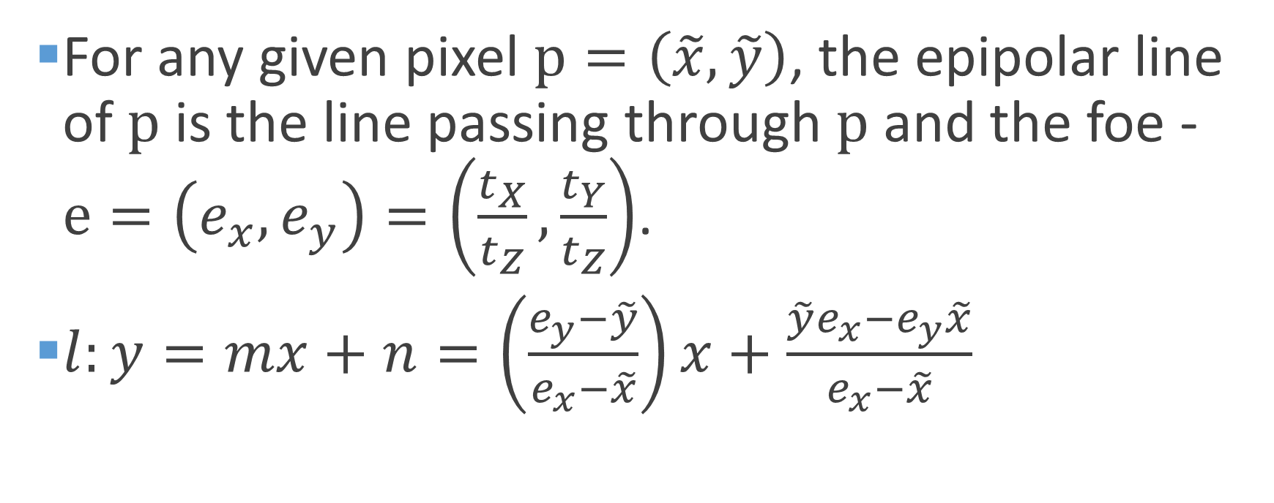
Epipolar line
For any given pixel $p=\left(\tilde{x},\tilde{y}\right)$, the epipolar line of $p$ is the line passing through $p$ and the foe - $e=\left(e_{x},e_{y}\right)=\left(\frac{t_{X}}{t_{Z}},\frac{t_{Y}}{t_{Z}}\right)$.
$l:y=mx+n=\left(\frac{e_{y}−\tilde{y}}{e_{x}−\tilde{x}}\right)x+\frac{\tilde{y}e_{x}−e_{y}\tilde{x}}{e_{x}−\tilde{x}}$

Slide 25
Previous - rotated

Slide 26
Current

Slide 27
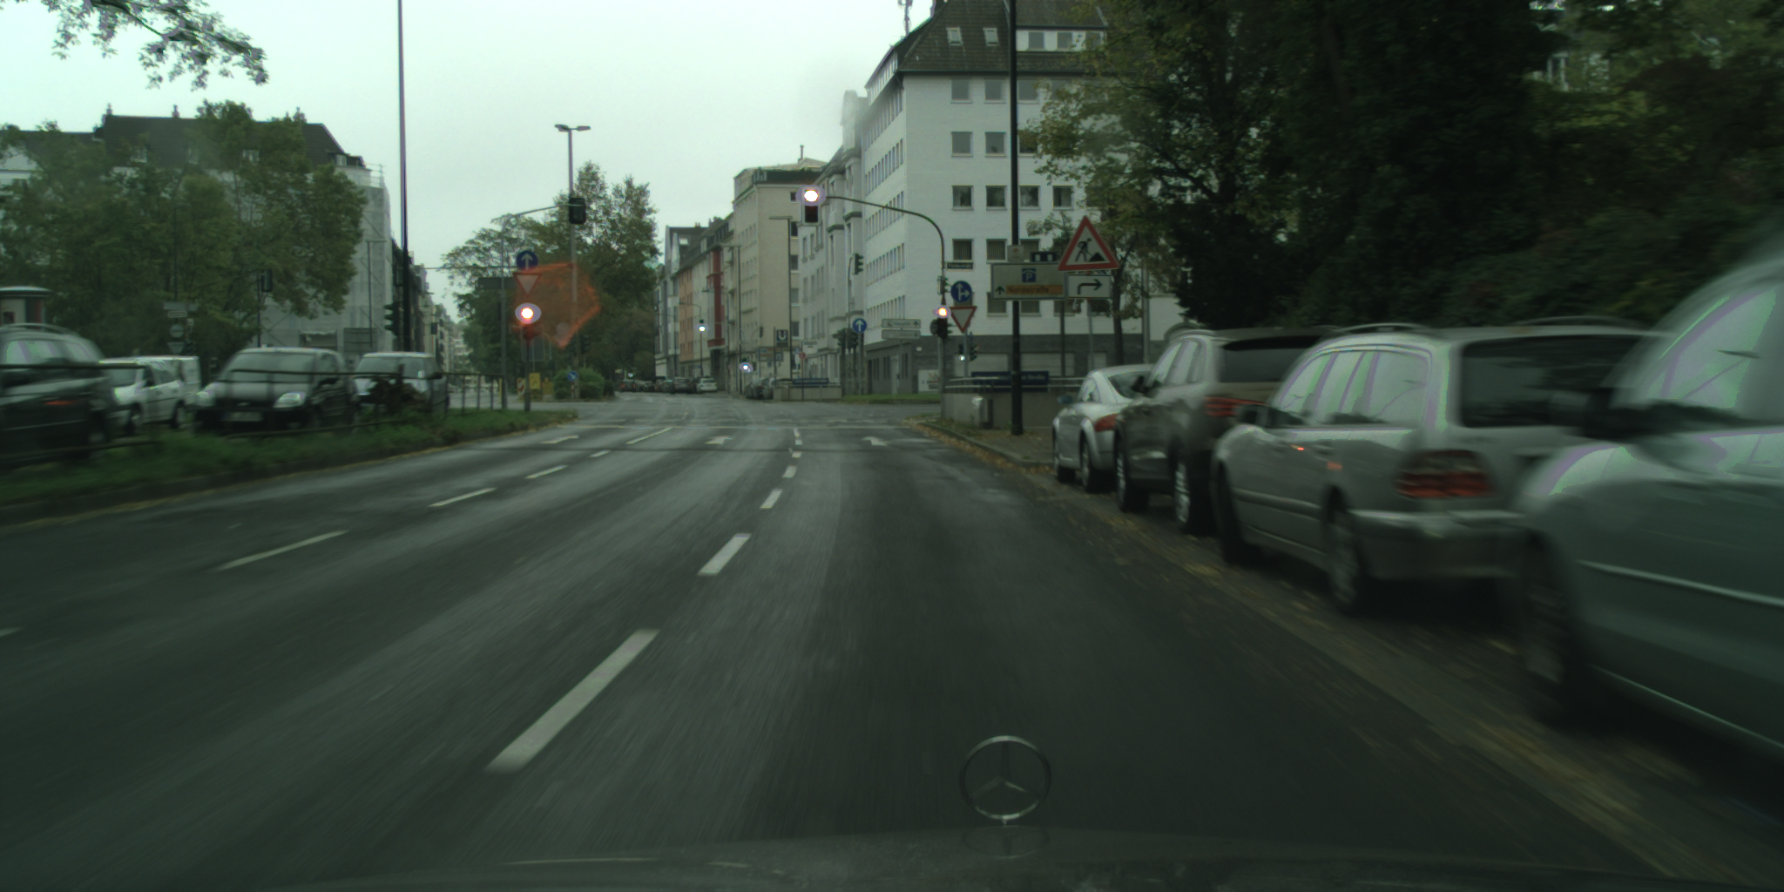
Current

Slide 28
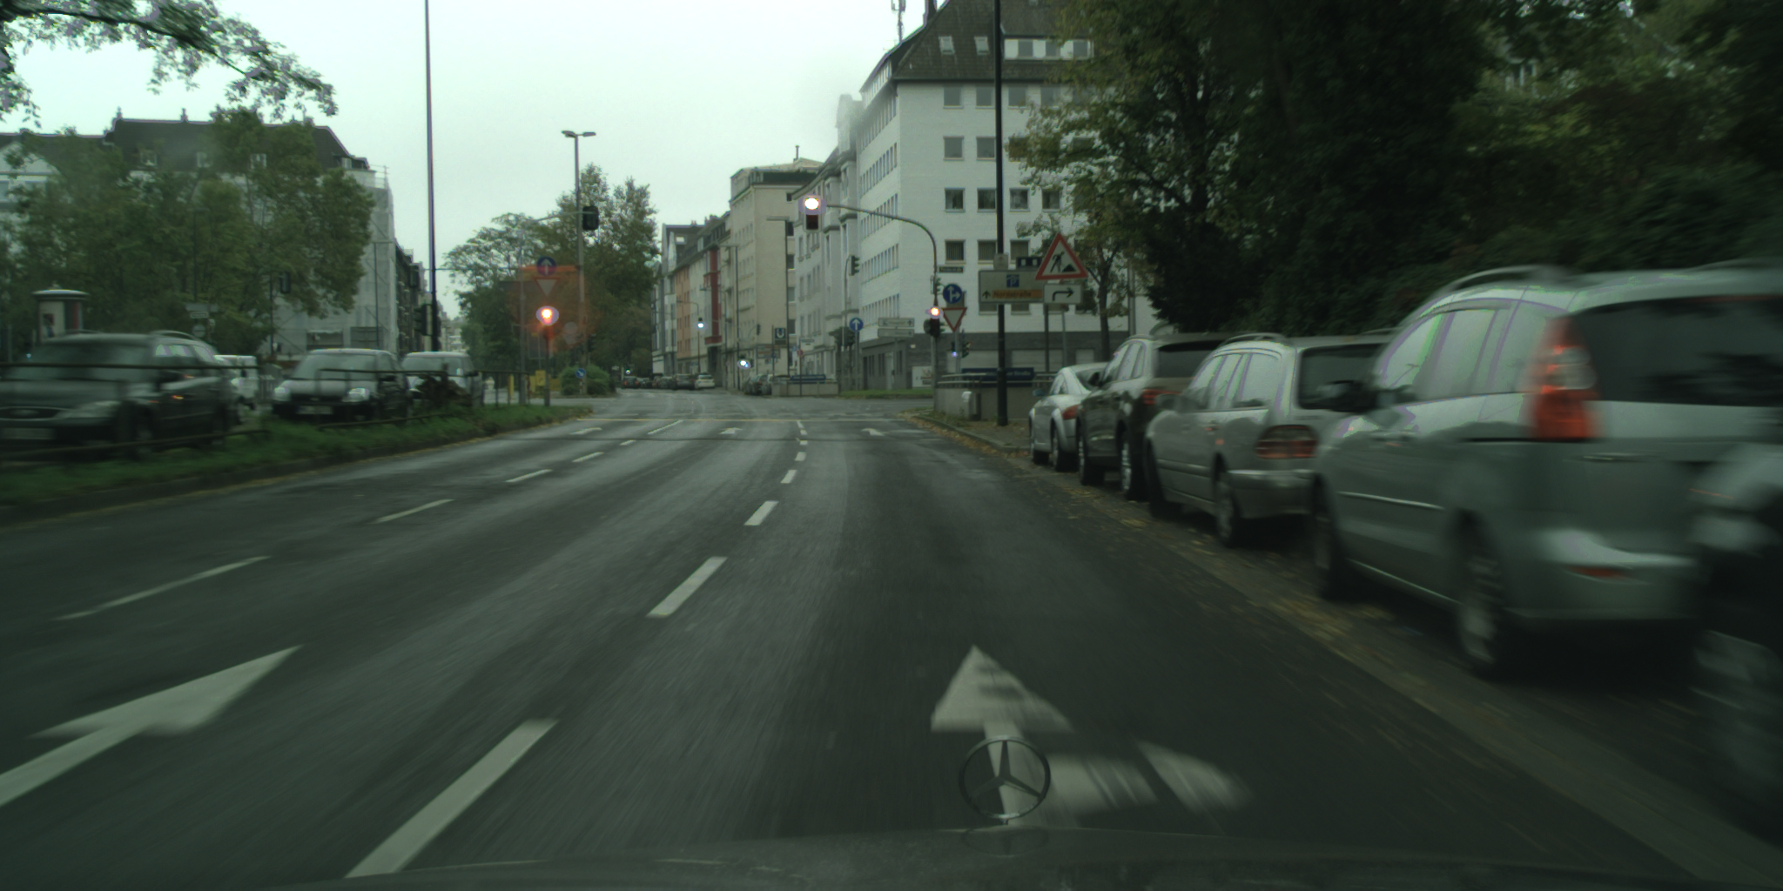
Rotated

Slide 29
Current

Slide 30
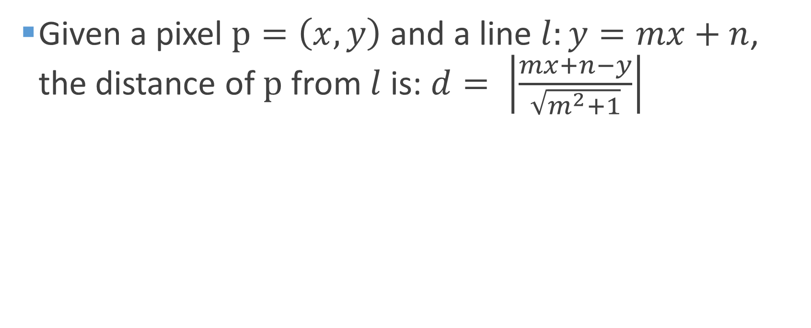
Distance of point from line
Given a pixel $p=\left(x,y\right)$ and a line $l:y=mx+n$, the distance of $p$ from $l$ is: $d= \left|\frac{mx+n−y}{\sqrt{m^{2}+1}}\right|$

Slide 31
Geometry of depth estimation after rotation

Slide 32
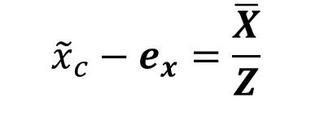
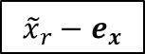

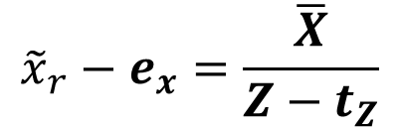
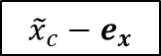
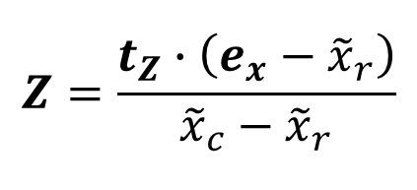
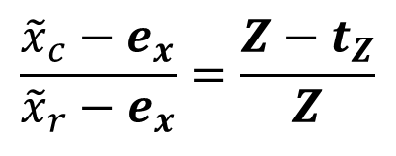
SFM calculation
$$\overline{X}$$
$${\tilde{x}}_{c}−e_{x}=\frac{\overline{X}}{Z}$$
$${\tilde{x}}_{r}−e_{x}=\frac{\overline{X}}{Z−t_{Z}}$$
Z
Z-t_{Z}
$$\frac{{\tilde{x}}_{c}−e_{x}}{{\tilde{x}}_{r}−e_{x}}=\frac{Z−t_{Z}}{Z}$$
$${\tilde{x}}_{c}−e_{x}$$
$${\tilde{x}}_{r}−e_{x}$$
$$Z=\frac{t_{Z}∙\left(e_{x}−{\tilde{x}}_{r}\right)}{{\tilde{x}}_{c}−{\tilde{x}}_{r}}$$
f

Slide 33
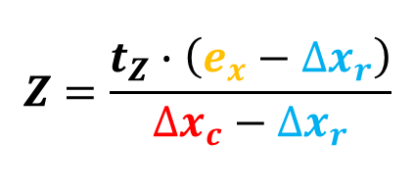
Current
$$Z=\frac{t_{Z}∙\left(e_{x}−{∆x}_{r}\right)}{{∆x}_{c}−{∆x}_{r}}$$

Slide 34
Full solution:
Input: EM between the images, lights in each image
Output: 3D estimation for each light
Normalize points
Rotate lights in previous image
Compute epipolar lines for lights in current image
Match rotated points to current points
Calculate Z distance from tracking
Calculate 3D position of each light

Slide 35
Questions?

